Slide 1
Solar collector

Slide 2
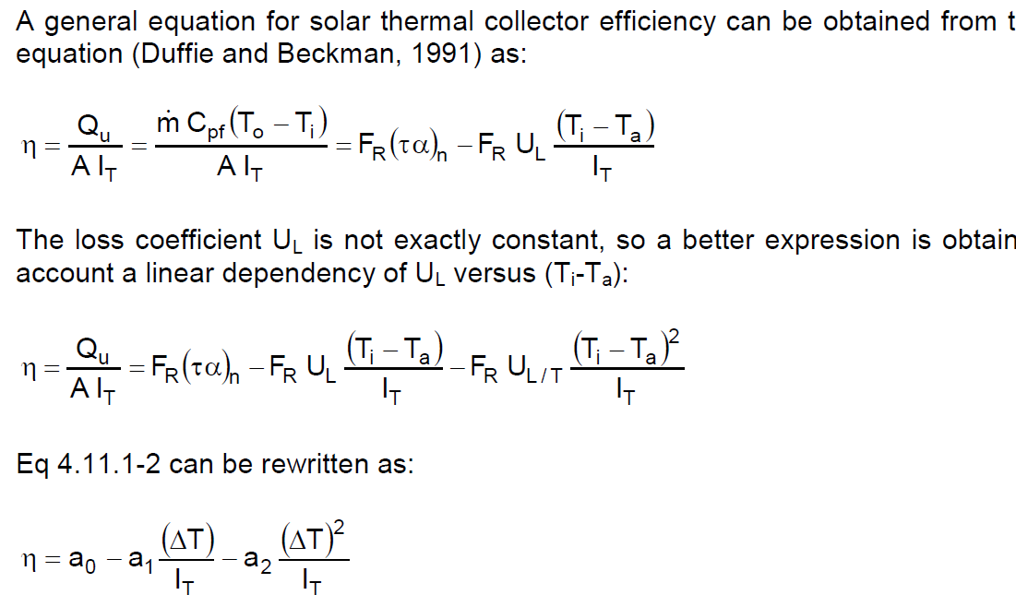
Trnsys Type1: flat plate collector (quadratic efficiency)
parameters a0,a1,a2
from collector tests (CEN,2001)
Determined for collector area = aperture area
In Europe usually determined for deltaT=Tav-Ta

Slide 3



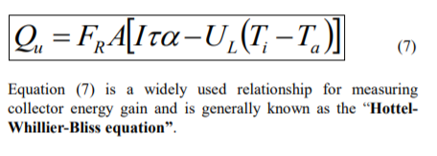
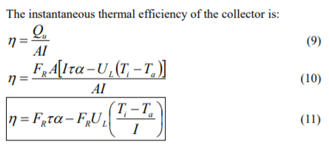
Heat Removal Factor
FR? Heat Removal Factor (cf Fabio Struckmann “Analysis of a Flat-plate Solar Collector”)
Rate of useful energy extracted by the collector (steady state):
= amount of heat carried away by collector fluid:
As it is difficult to define the collector average temp Tc in (4) =>
So, FR says which fraction of the maximum possible useful energy gain (when the whole collector is at Ti), is the actual useful energy gain (going to the collector fluid):

Slide 4
Trnsys Type1: corrections
Flow rate different from test
Collectors in series
Non normal solar incidence

Slide 5
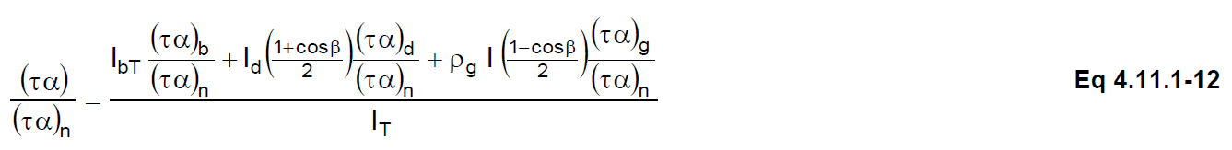
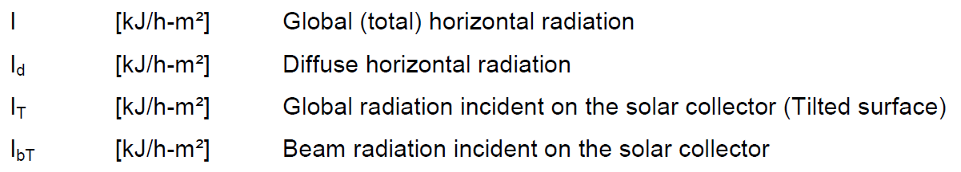
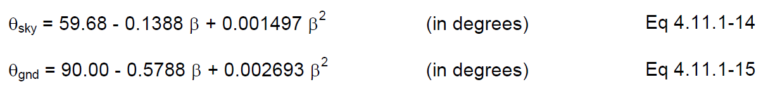
Trnsys Type1: correction non normal solar incidence
τα in test is for normal incidence (τα)n
τα for non-normal solar incidence should be used => a0 * (τα)/(τα)n
(τα)b/(τα)n = IAM for beam radiation
from tests,
supplied versus angle of incidence θ on collector
for tube collector different IAM for longitudinal and transversal direction
flat plate collector is assumed to be symmetrical (one direction is enough)
total IAM is product of IAM’s for different directions
(τα)d/(τα)n = IAM for diffuse radiation (sky diffuse, ground diffuse)
Determined based on equivalent incidence angle
Not correct? See next slide

Slide 6
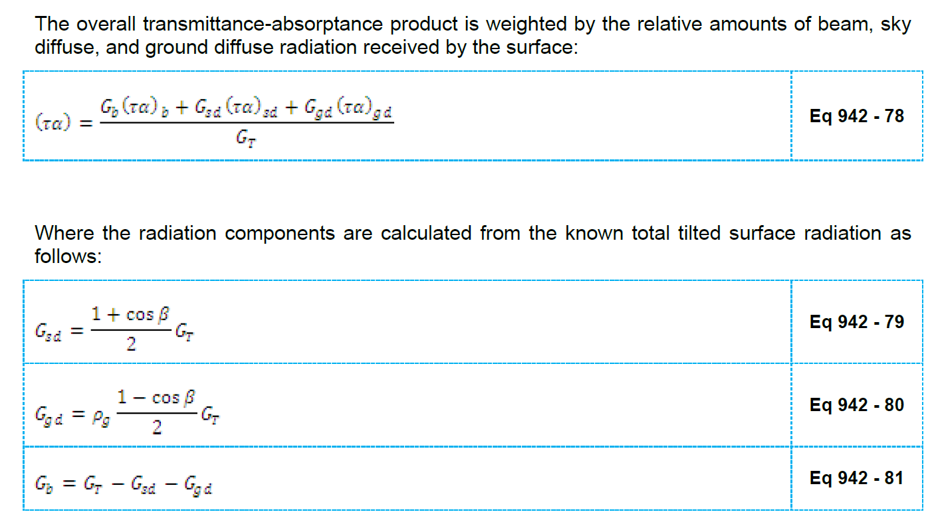
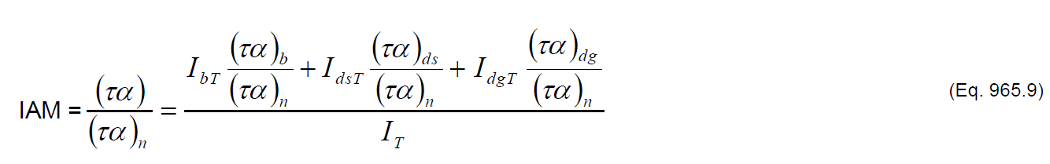
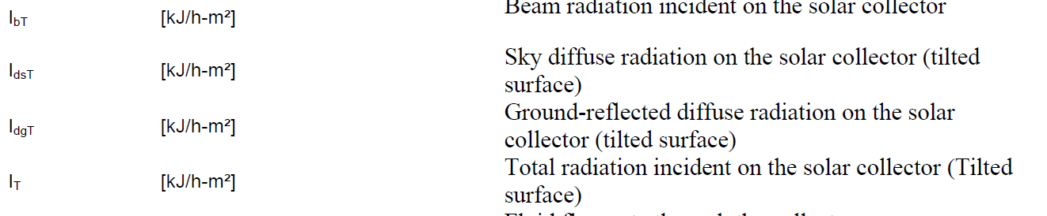
(τα)/(τα)n?
According to Type942 and type 965 resp.:

Slide 7
Trnsys Type1: corrections
Flow rate different from test
Collectors in series
Is this necessary?

Slide 8
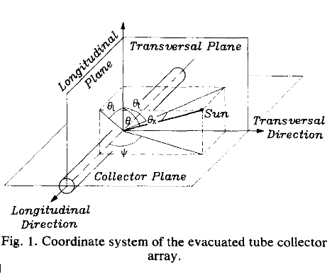
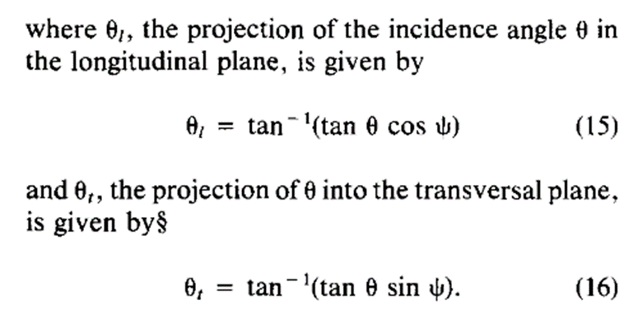
Incident angle in longitudinal and transversal direction
Cf Solar transmittance characteristics of evacuated tubular collectors with diffuse black collectors. P.-H. Theunissen, W.A. Beckman

Slide 9
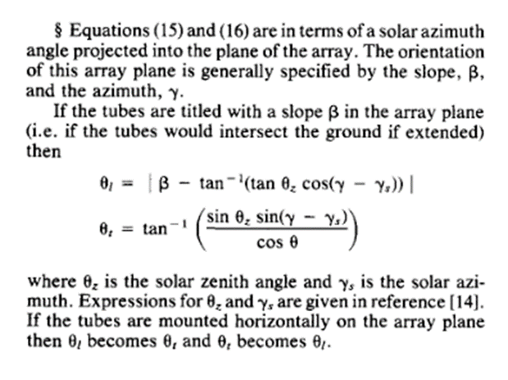
Incident angle in longitudinal and transversal direction
Cf Solar transmittance characteristics of evacuated tubular collectors with diffuse black collectors. P.-H. Theunissen, W.A. Beckman
But, in (15) and (16) Ψ is the angle between collector and sollar azimuth in the collector plane, so for non-horizontal collector with slope β:

Slide 10
comparison matlab model with trnsys Type1 and 71
!!! Coefficients a1,a2 in eff=a0-a1*deltaT/It – a2*deltaT²/It are given in W/m²K or W/m²K² !! (so correction needed for trnsys kJ/h)
!! This simplified model doesn’t consider cooling/heating of collector itself (for instance cooling during night)/in TRNSYS collector fluid is cooling down if there is no solar radiation…
Seems like It is important, inc angle and IAM not that much …

Slide 11
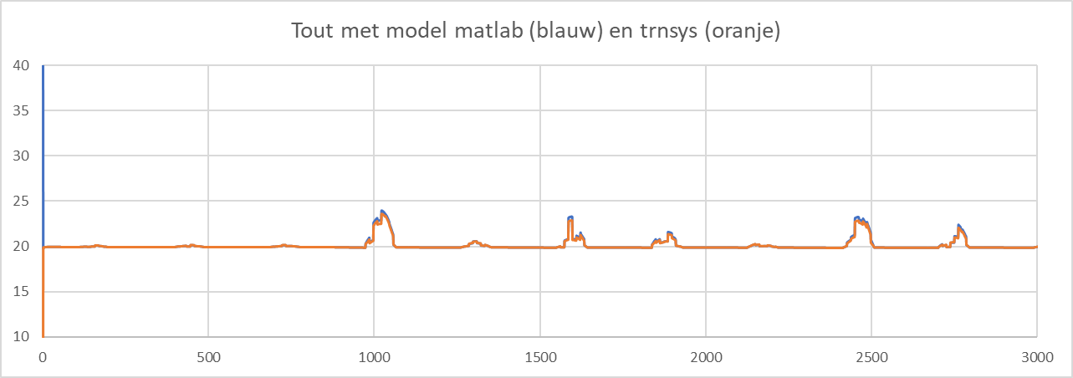
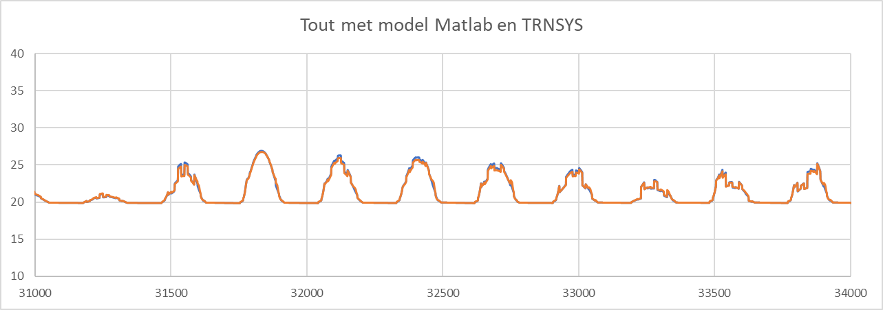
comparison matlab model with trnsys Type1 and 71

